Slide 1
Relating COs-POs-PSOs-PEOs-MISSION-VISION
Institute Vision
Institute Mission
Department Vision
Department Mission
Program Educational Objectives( PEOs)
Program Outcomes(POs)
Program Specific Outcomes (PSO)
Preparation of Curriculum in-line Blooms Taxonomy
and CO-PO-PSO Mapping
Construction of Program Articulation Matrix and Course Articulation Matrix
.
Every Year Decide Threshold Values for CO Attainment Levels and PO-PSO Attainment Levels
Curriculum Execution uing Direct and Indirect Assessment Tools
After Each Academic Year
Check for Attainment and suggest strategies for Improvement

Slide 2
VISION-MISSION-PEO-PO-PSO-CO--PERSPECTIVE
Vision – Indicates aspirations of the Institute/Department
Mission – states the broad approach to achieve aspirations
PEOs – broad statements that describe the career and professional accomplishments to be seen after 5 years, that the program is preparing graduates to achieve in line with mission and vision.
POs– describe what students are expected to know In terms of the skills, knowledge, and behaviors and would be able to do by the time of graduation.
PSOs– describe what the graduates of a specific engineering program should be able to do.
COs– describe what a students can do after the successful completion of a course. The CO statements are defined by considering the course content and PO/PSO compatibility. The keywords used to define COs are based on Bloom’s Taxonomy.

Slide 3
Our Vision and Mission
Vision of the Institution
"To be globally acclaimed Institute in Technical Education and Research for holistic Socio-economic development"
Vision of the Department
"To be a leader in the world of computing education practising creativity and innovation"
Institute Mission | Department Mission
To ensure that 100% students are employable and employed in Industry, Higher Studies, become Entrepreneurs, Civil / Defense Services / Govt. Jobs and other areas like Sports and Theatre | To ensure students' employability by developing aptitude, computing, soft, and entrepreneurial skills
To strengthen Academic Practices in terms of Curriculum, Pedagogy, Assessment and Faculty Competence | To enhance academic excellence through effective curriculum, blended learning and comprehensive assessment with active participation of industry
Promote Research Culture among Students and Faculty through Projects and Consultancy | To cultivate research culture resulting in knowledge-base, quality publications, innovative products and patents
To make students Socially Responsible Citizen | To develop ethical consciousness among students for social and professional maturity to become responsible citizens

Slide 4
Programme Education Objectives- Perspective
PEO | PEO Focus | PEO Statement
PEO1 | Preparation | To prepare the students with the knowledge of Basic and Engineering Sciences along with domain specific fundamentals courses [ Phy, Che, Maths, Electrical, Drawing, CF, Logic, DS ]
PEO2 | Core competence | To prepare the students to identify, formulate, comprehend, analyze, design and solve engineering problems with the knowledge of core courses [Core Competency through core subjects] [ DS, CA, CA, ADE, OOP, OS, DBMS, CN, SE, AI, CC]
PEO3 | Breadth | To equip the students with the ability to design, simulate, experiment, analyze, optimize and interpret to build them into industry ready graduates using technology [Technical Competency through Technology ] [WT, CC, CS, DS, Cli-Ser, PC-GPU, OOMD and Electives ]
PEO4 | Professiona lism | To provide awareness on importance of soft skills, holistic personality development, professional attitude, ethical issues, team work, responsibility, accountability, multidisciplinary approach, relate engineering issues to social context.
PEO5 | Learning Environment | To provide students with an academic environment and make them aware of excellence in professional field through continuous up-gradation, adaptability with upcoming technologies,, quest for need base learning, urge of discovery, creativity, inventiveness, the life-long learning [MOOC, Certifications]

Slide 5
Our - Programme Education Objectives [PEOs]
PEO | PEO Focus | PEO Statement
PEO1 | Preparation | Demonstrate application of sound engineering foundations to be a committed technology workforce
PEO2 | Core competence | Apply mathematical and computing theory knowledge base to provide realistic computer engineering solutions
PEO3 | Breadth | Exhibit problem solving skills and engineering practices to address problems faced by industry with innovative methods, tools and techniques
PEO4 | Professionalism | Develop professional and ethical practices adopting effective guidelines to acquire desired soft skills in societal and global context
PEO5 | Learning Environment | Aim for continuing education and entrepreneurship in emerging areas of computing

Slide 6
Program Specific Outcomes(PSOs) (04)
PSO1: Select and incorporate appropriate computing theory principles, data structures and algorithms, programming paradigms to innovatively craft scientific solution addressing complex computing problems.
PSO2: Adapt to new frontiers of science, engineering and technology by getting acquainted with heterogeneous computing environments and platforms, computing hardware architectures and organizations through continuous experimentation.
PSO3: Conceive well-formed design specifications and constructs assimilating new design ideas and facts for identified real world problems using relevant development methodologies and practices, architecture styles and design patterns, modeling and simulation, and CASE tools.
PSO4: Exercise research and development aptitude focusing knowledge creation and dissemination through engineering artifacts construction, preparation and presentation of engineering evidences using procedures, techniques, guidelines, and standards considering technology migration and evolution.

Slide 7
Course Outcome - Perspective
Course Outcomes statements - describe what a students can do after the successful completion of a course. The CO statements are defined by considering the course content.
Cos - Number of Outcomes for a Course are taken 6
The keywords used to define COs are based on Bloom’s Taxonomy

Slide 8
Books
Text Books
Stalling William; “Operating Systems”, 6thEdition, Pearson Education.
Silberschatz A., Galvin P., GagneG.; “Operating System Concepts”, 9th Edition, JohnWiley and Sons.
D M Dhamdhere; "Systems Programming & Operating Systems"; Tata McGraw HillPublications, ISBN – 0074635794
John J Donovan; " Systems Programming " ; Tata Mc-Graw Hill edition , ISBN-13978-0-07-460482-3
8
Notes:
8
8
8
8
8
8
8

Slide 9
Books
Text Books
Silberschatz A., Galvin P., Gagne G ;“Operating System Principles” 7th Edition John Wiley and Sons.
YashavantKanetkar; “Unix Shell Programming”, 2 nd Edition, BPB Publications.
Forouzan B. A., Gilberg R. F.; “Unix And Shell Programming”, 1 st Edition, Australia Thomson Brooks Cole.
Achyut S. Godbole ,AtulKahate; “Operating Systems”, 3 rd Edition, McGraw Hill.
Robert Love, " Linux System Programming " ;O’Reilly, ISBN 978-0-596-00958-8
Mahesh Jadhav; " Easy Linux Device Driver "; HighTechEasy publishing, Second edition.
Ray Duncan; “Advanced MSDOS programming”; Microsoft press
9
Notes:
9
9
9
9
9
9
9

Slide 10
Course Project: OPERATING SYSTEMS
Implementation of a multiprogramming operating system:
1. Stage I:
i. CPU/ Machine Simulation
ii. Supervisor Call through interrupt
2. Stage II:
i. Paging
ii. Error Handling
iii. Interrupt Generation and Servicing
iv. Process Data Structure
3. Stage III:
i. Multiprogramming
ii. Virtual Memory
iii. Process Scheduling and Synchronization
iv. Inter-Process Communication
v. I/O Handling, Spooling and Buffering
Notes:
10

Slide 11
Introduction to Operating System
11
Notes:
11
11
11
11
11
11
11
11

Slide 12
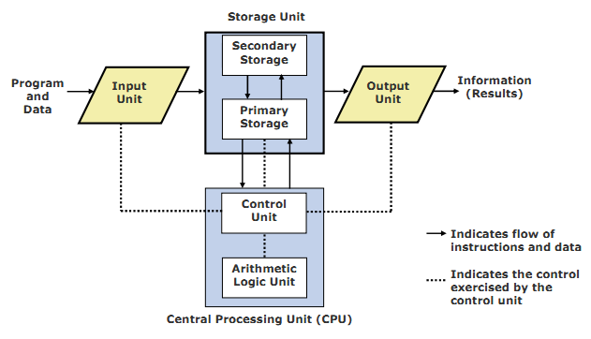
Block Diagram of a Computer (Logical)
12
Notes:
12
12
12

Slide 13
Operating System (OS)
What do you do with just computer hardware?
If someone gives you a computer with no software whatsoever, how do you get it to do anything?
You write a program that runs on the hardware
In the early days, that was the way it worked ...
You started with just the bare hardware
You wrote a program that did everything:
Including managing all aspects of the hardware
Including solving your particular problem
Your program was all the computer did!
13
Notes:
13
13
13

Slide 14
Without an OS
Each program runs directly on the hardware
Each program must do everything
Each program needs to know the details of the hardware and how to use it
If the hardware changes, the program must change as well
The hardware supports only one program at a time - each user must wait until the previous program is done to “share” the hardware with other users.
Writing programs is incredibly complex and expensive
OS is like an extended machine to provide a better interface for convenience.
14
Notes:
14
14
14

Slide 15
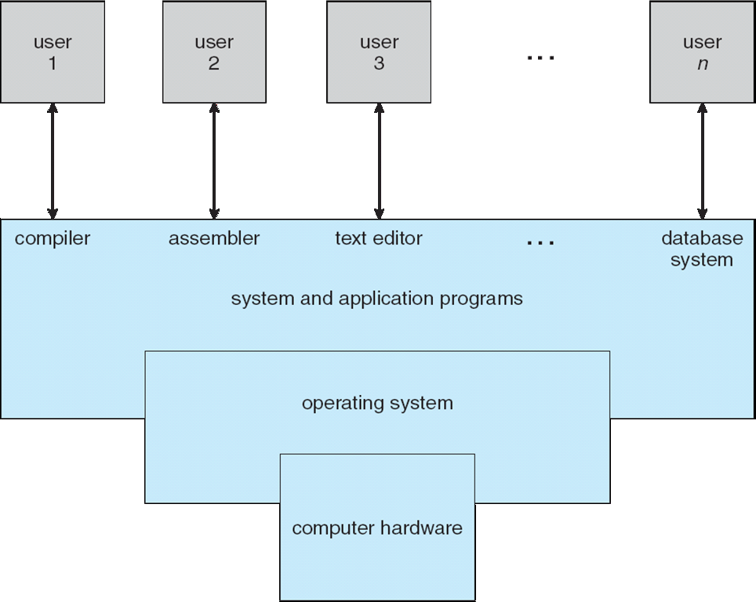
Four Components of a Computer System:
15
Notes:
15
15
15
15
15
15
15

Slide 16
Computer System Structure
Computer system can be divided into four components:
Hardware – provides basic computing resources
CPU, memory, I/O devices
Operating system
Controls and coordinates use of hardware among various applications and users
Application programs – define the ways in which the system resources are used to solve the computing problems of the users
Word processors, compilers, web browsers, database systems, video games
Users
People, machines, other computers
16
Notes:
16
16
16
16
16
16
16

Slide 17
Operating System (OS)
Integrated set of programs that controls the resources of a computer system
Provides its users with an interface which is more convenient to use than bare machine
Directly sits on top of the hardware and controls it
Manages computer hardware
Provides a basis for application programs
Acts as an intermediary between computer user and computer hardware
17
Notes:
17
17
17

Slide 18
Introduction
“An operating system is similar to a government. Like a government, it performs no useful function by itself. It simply provides an environment within which other programs can do useful work”
“The fundamental goal of computer systems is to execute user programs and to make solving user problems easier”
18
Notes:
18
18
Suppose we had two programs, running on the bare hardware which by themselves accomplished different user goals. There would likely be much shared code across the two– e.g., managing memory, accessing disk, accessing graphical displays. An OS collects this software into one place.

Slide 19
Views of an Operating System
Resource Allocator
Operating system manages or allocates resources
What resources?
CPU time, RAM Memory, disk & other I/O devices, interrupt numbers (IRQ’s), files, network ports & sockets, and other software resources
Who uses the resources?
Resource users: One or more user processes & threads
Control Program
Operation and control of hardware devices
Implements security and protection
Execution of user program to prevent errors and prevent improper use of the computer
19
Notes:
19
19

Slide 20
Goals of an OS
Execute user programs and make solving user problems easier
Make the computer system convenient to use
Use the computer resources in an efficient manner
Ability to evolve
Can you think of reasons which make evolution necessary?
H/W changes, new services, fixes
Different design goals for different OS
Mainframes, PC, Handheld
20
Notes:
20
20
20
Hardware changes
New services
Fixes
20

Slide 21
The Role of an OS
A computer is a set of resources for the movement, storage, and processing of data.
The OS is responsible for managing these resources.
21
Notes:
21
21
21
21
21
21

Slide 22
Operating System as Software
The OS functions in the same way as an ordinary computer software
It is a program that is executed by the CPU
The OS frequently relinquishes control and must depend on the processor to allow it to regain control.
22
Notes:
22
22
22
22
22
22
The OS functions in the same way as ordinary computer software;
It is a program or suite of programs executed by the processor.
The OS frequently relinquishes control and must depend on the processor to allow it to regain control.
22

Slide 23
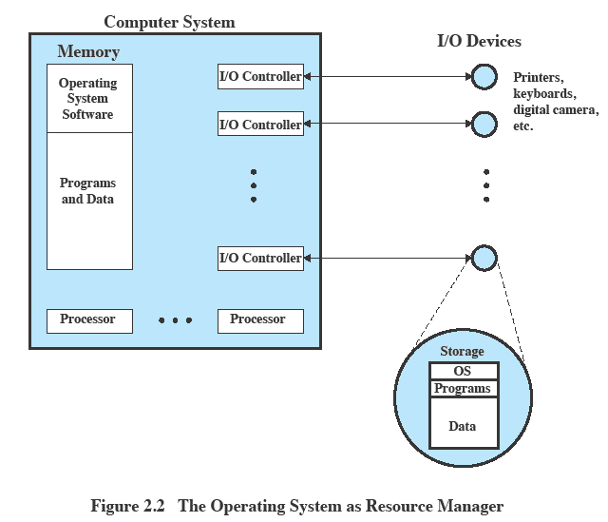
OS as Resource Manager
23
Notes:
23
23
23
23
23
23
23

Slide 24
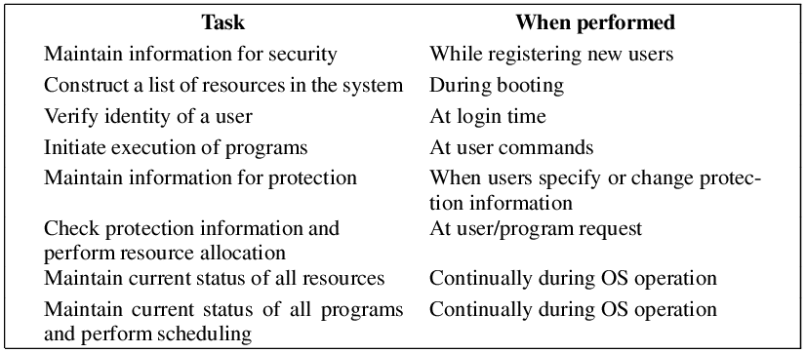
Common Tasks by OS
24
Notes:
24
24
24

Slide 25
Basic function of OS:
Process Management
Main memory management
Secondary storage management
I/O Subsystem Management
File Management
25
Notes:
25
25
25
25
25
25
25

Slide 26
1. Process Management
A process is a program in execution. It is a unit of work within the system. Program is a passive entity, process is an active entity.
Process needs resources to accomplish its task
CPU, memory, I/O, files
Initialization data
Process termination requires reclaim of any reusable resources
Single-threaded process has one program counter specifying location of next instruction to execute
Process executes instructions sequentially, one at a time, until completion
Multi-threaded process has one program counter per thread
Typically system has many processes, some user, some operating system running concurrently on one or more CPUs
Concurrency by multiplexing the CPUs among the processes / threads
26
Notes:
26
26
26
26
26
26
26

Slide 27
Process Management Activities
The operating system is responsible for the following activities in connection with process management:
Creating and deleting both user and system processes
Suspending and resuming processes
Providing mechanisms for process synchronization
Providing mechanisms for process communication
Providing mechanisms for deadlock handling
27
Notes:
27
27
27
27
27
27
27

Slide 28
2. Main Memory Management
Main memory -array of words/bytes
All data in memory before and after processing
All instructions in memory in order to execute
Memory management determines what is in memory when
Optimizing CPU utilization and computer response to users
Memory management activities
Keeping track of which parts of memory are currently being used and by whom
Deciding which processes (or parts thereof) and data to move into and out of memory
Allocating and deallocating memory space as needed
28
Notes:
28
28
28
28
28
28
28

Slide 29
3. Secondary Storage Management
Main memory is small and volatile
Secondary storage is large and nonvolatile
OS activities related to disk management include
Free space management
Storage allocation
Disk scheduling
29
Notes:
29
29
29
29
29
29
29

Slide 30
4. I/O Subsystem management
One purpose of OS is to hide peculiarities of hardware devices from the user
I/O subsystem responsible for
Memory management of I/O including
buffering (storing data temporarily while it is being transferred),
caching (storing parts of data in faster storage for performance),
spooling (the overlapping of output of one job with input of other jobs)
General device-driver interface
Drivers for specific hardware devices
30
Notes:
30
30
30
30
30
30
30

Slide 31
5. File Management
OS provides uniform, logical view of information storage
Abstracts physical properties to logical storage unit - file
Each medium is controlled by device (i.e., disk drive, tape drive)
Varying properties include access speed, capacity, data-transfer rate, access method (sequential or random)
File-System management
Files usually organized into directories
31
Notes:
31
31
31
31
31
31
31

Slide 32
FS Management Activities
Creating and deleting files
Creating and deleting directories
Supporting primitives for manipulating files and directories
Mapping files onto secondary storage
Backing up files on stable (non-volatile) storage media
i
Notes:
32
32
32

Slide 33
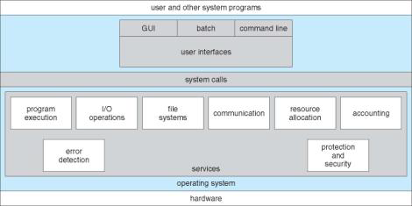
OS Services
A view of OS services
33
Notes:
33
33
33

Slide 34
Operating System Services
Operating-system provides certain services to programs and users of that program.(For convenience of programmers)
User interface - Almost all operating systems have a user interface (UI)
Varies between Command-Line (CLI), Graphics User Interface (GUI), Batch
Program execution - The system must be able to load a program into memory and to run that program & end execution, either normally or abnormally (indicating error)
I/O operations - A running program may require I/O, which may involve a file or an I/O device
For protection & security IO done by OS not by user
34
Notes:
34
34
34
34
34
34
34
34

Slide 35
Operating System Services (Cont)
File-system manipulation - The file system is of particular interest. Obviously, programs need to read and write files and directories, create and delete them, search them, list file Information, permission management.
Communications – Processes may exchange information, on the same computer or between computers over a network
Communications may be via shared memory(Tightly coupled system) or through message passing(Loosely coupled system) packets moved by the OS
35
Notes:
35
35
35
35
35
35
35
35

Slide 36
Operating System Services (Cont)
Error detection – OS needs to be constantly aware of possible errors
May occur in the CPU and memory hardware(memory error,power failure)
In I/O devices(connection failure in n/w)
In user program(access to illegal memory, arithmetic overflow)
For each type of error, OS should take the appropriate action to ensure correct and consistent computing.
Debugging facilities can greatly enhance the user’s and programmer’s abilities to efficiently use the system
36
Notes:
36
36
36
36
36
36
36
36

Slide 37
Operating System Services (Cont)
Another set of OS functions exists for ensuring the efficient operation of the system itself via resource sharing
Resource allocation - When multiple users or multiple jobs running concurrently, resources must be allocated to each of them
Many types of resources - Some (such as CPU cycles, main memory, and file storage) may have special allocation code, others (such as I/O devices) may have general request and release code
Accounting - To keep track of which users use how much and what kinds of computer resources
37
Notes:
37
37
37
37
37
37
37
37

Slide 38
Operating System Services (Cont)
Protection and security - The owners of information stored in a multiuser or networked computer system may want to control use of that information, concurrent processes should not interfere with each other
Protection involves ensuring that all access to system resources is controlled
Security of the system from outsiders requires user authentication(password) , defending external I/O devices modem,NIC from invalid access attempts
38
Notes:
38
38
38
38
38
38
38
38

Slide 39
User – OS Interface
GUI
Graphical User Interface
Desktop, icons, mouse
CLI
Command Line Interface
Allows direct command entry
Sometimes implemented in kernel, sometimes by systems program
Command interpreter
Windows: Command shell
UNIX/LINUX: Terminal – bash, ksh, csh: shells
Built-in commands vs external commands
Notes:
39
39
39

Slide 40
Protection and Control
Ensuring proper operation of the operating system, and programs
Examples
(a) only certain users can access certain files;
(b) restricted access to operating system parts of RAM;
(c) restrictions about which instructions can be executed by applications;
(d) restricted access to RAM of other processes
40
Notes:
40

Slide 41
Protection
A main way that modern operating systems provide protection is through use of dual-mode hardware features
User-mode & kernel mode
Hardware boots in kernel mode; switches to user-mode when running user processes
System call or interrupt enables switch back to kernel mode
41
Notes:
41
41

Slide 42

Protection modes
User mode
limited access to RAM memory; just the memory of a single program running
limited access to machine instructions; illegal to execute I/O instructions, interrupt management instructions and some others
kernel mode
access to all RAM memory
access to all machine instructions
User vs. kernel mode implemented as a bit in CPU
42
Notes:
42
42

Slide 43
So, if we have these protection modes, how does a process gain access to the OS?
How can a user process request an operation or function be carried out by the operating system?
43
Notes:
43

Slide 44
System Calls
User programs are not allowed to access system resources directly. They must ask the OS to do that for them.
OS provides a set of functions that can be called by user programs to request for OS services. These functions are called “system calls”
System calls run in kernel mode.
They can be called by executing a special instruction (trap or software interrupt) which causes processor to switch to the kernel mode and jump to a previously defined location in the kernel.
When the system call finishes, processor returns to the user program and runs in user mode.
44
Notes:
44
44
44
44
44

Slide 45
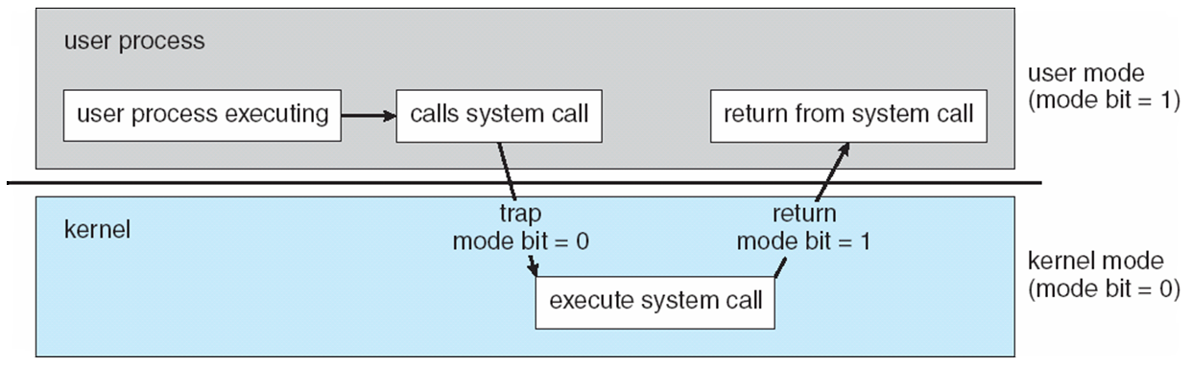
Dual Mode Operation
Figure : Transition from User to Kernel Mode
Kernel mode is also called Supervisor mode
Notes:
45

Slide 46
System Calls
System calls provide the interface between a running program and the operating system.
Generally available as assembly-language instructions.
Languages defined to replace assembly language for systems programming allow system calls to be made directly (e.g., C, C++)
Mostly accessed by programs via a high-level Application Program Interface (API) rather than direct system call use.
Three most common APIs are Win32 API for Windows, POSIX API for POSIX-based systems (including virtually all versions of UNIX, Linux, and Mac OS X), and Java API for the Java virtual machine (JVM)
Why use APIs rather than system calls?
46
Notes:
46
46
46
46
46
46
46
46

Slide 47
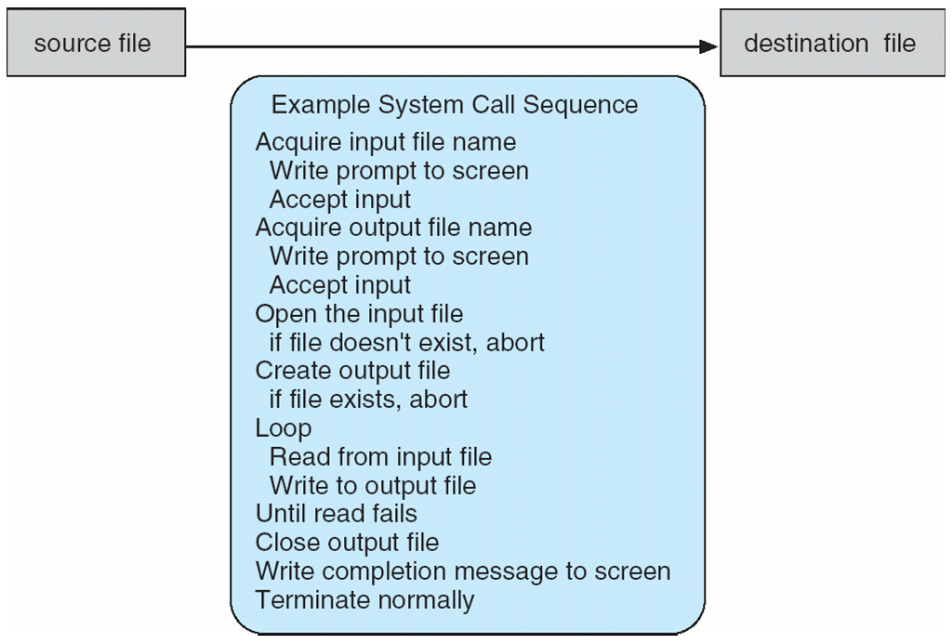
Example of System Calls
System call sequence to copy the contents of one file to another file
How system calls are used
47
Notes:
47
47
47
47
47
47
47
47

Slide 48
API
An API is a set of functions provided by an operating system or other system software.
An application program calls the functions to request the services.
An API clearly defines how to call functions and what the results are. (API is specification, not implementation)
Examples: APIs for file system, graphics user interface, networking, etc
48
Notes:
48
48
48

Slide 49
Advantages of using APIs
1. Portability: User programs that follow the API’s definition are portable.
2. An API can provide a common interface for different implementations of a service.
For example, the UNIX file system API is the same for all kinds of devices.
3. Using an API allows upgrading system software without changing user programs
4. APIs are faster than system call as there is no need of mode switch.
49
Notes:
49
49
49
49
49
49

Slide 50
System Call Implementation
Typically, a number associated with each system call
System-call interface maintains a table indexed according to these numbers
The system call interface invokes intended system call in OS kernel and returns status of the system call and any return values
The caller need know nothing about how the system call is implemented
Just needs to obey API and understand what OS will do as a result call
Most details of OS interface hidden from programmer by API
Managed by run-time support library (set of functions built into libraries included with compiler)
50
Notes:
50
50
50
50
50
50
50
50

Slide 51
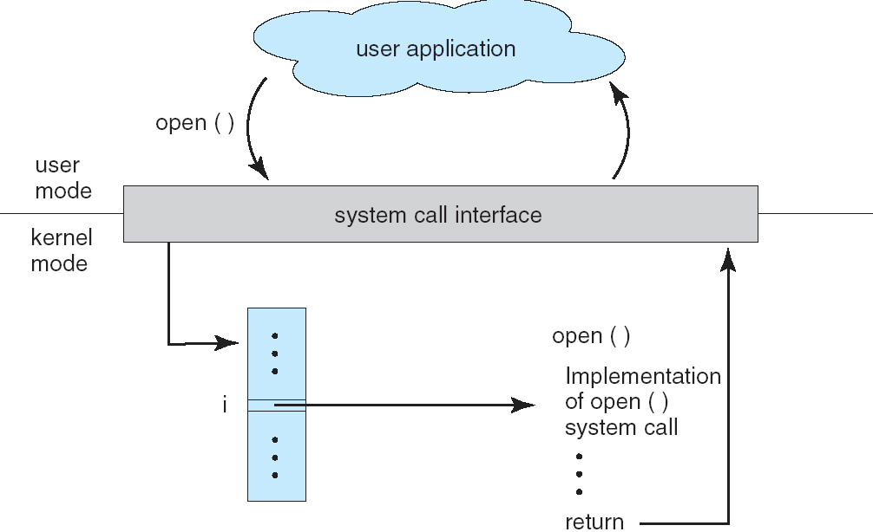
API – System Call – OS Relationship
51
Notes:
51
51
51
51
51
51
51
51

Slide 52
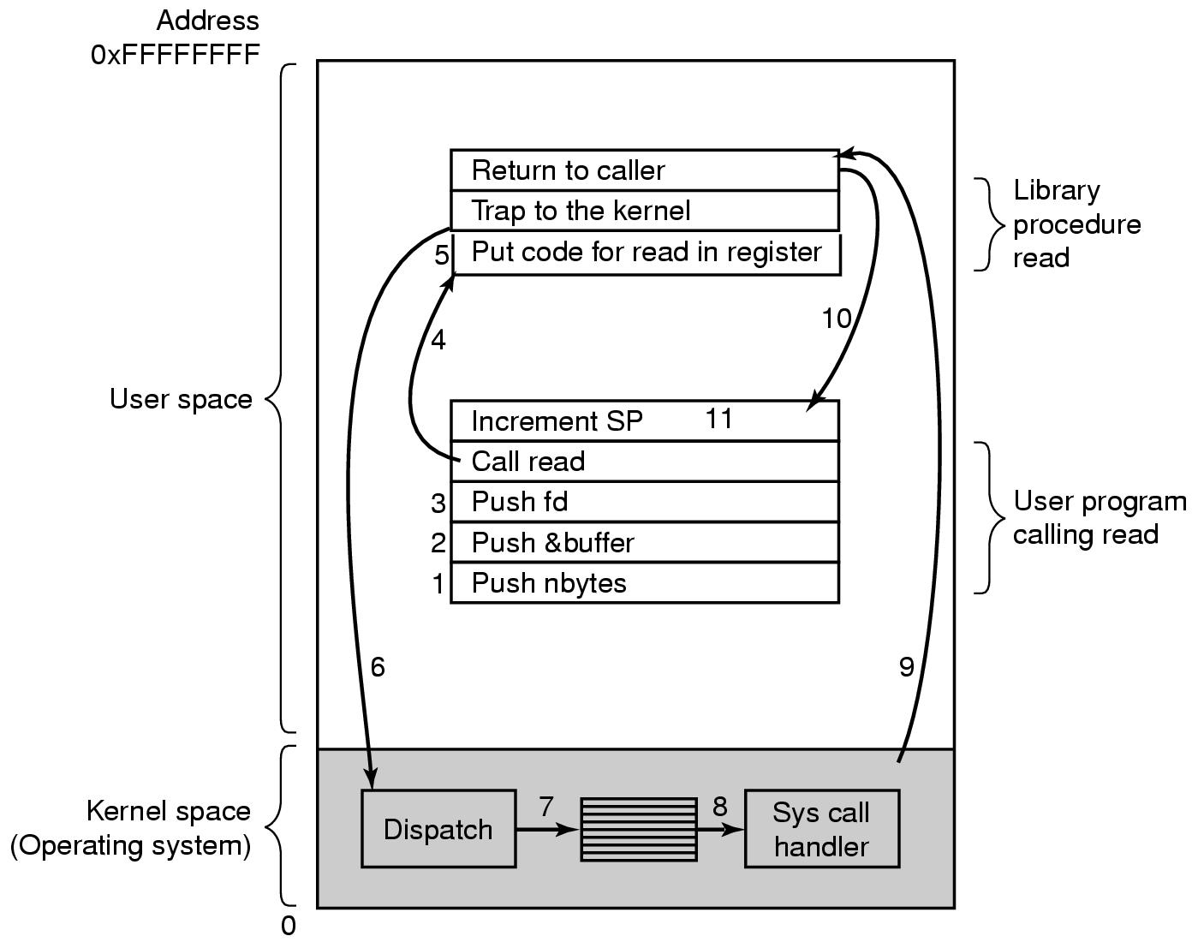
Steps in Making a System Call
There are 11 steps in making the system call
count=read (fd, buffer, nbytes)
52
Notes:
52
52
52
52
52
52

Slide 53
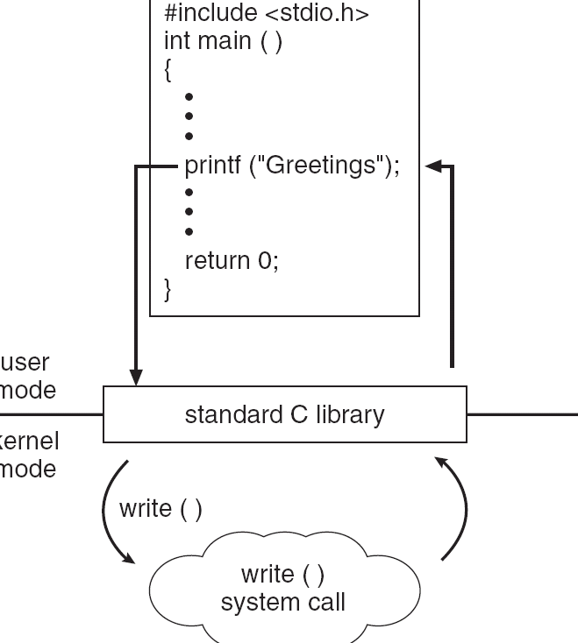
Standard C Library Example
C program invoking printf() library call, which calls write() system call
53
Notes:
53
53
53
53
53
53
53
53

Slide 54
System Call Parameter Passing
Often, more information is required than simply identity of desired system call
Exact type and amount of information vary according to OS and call
Three general methods used to pass parameters to the OS
Simplest: pass the parameters in registers
In some cases, may be more parameters than registers
Parameters stored in a block, or table, in memory, and address of block passed as a parameter in a register
This approach taken by Linux and Solaris
Parameters placed, or pushed, onto the stack by the program and popped off the stack by the operating system
Block and stack methods do not limit the number or length of parameters being passed
54
Notes:
54
54
54
54
54
54
54
54

Slide 55
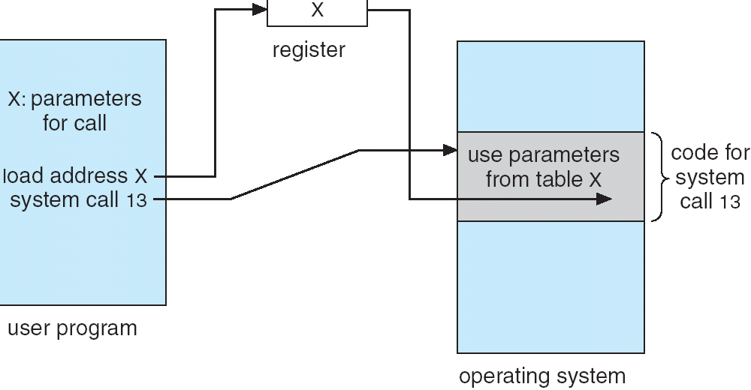
Parameter Passing via Table
55
Notes:
55
55
55
55
55
55
55
55

Slide 56
Types of System Calls
Process control
File management
Device management
Information maintenance
Communications
Protection
56
Notes:
56
56
56
56
56
56
56
56

Slide 57
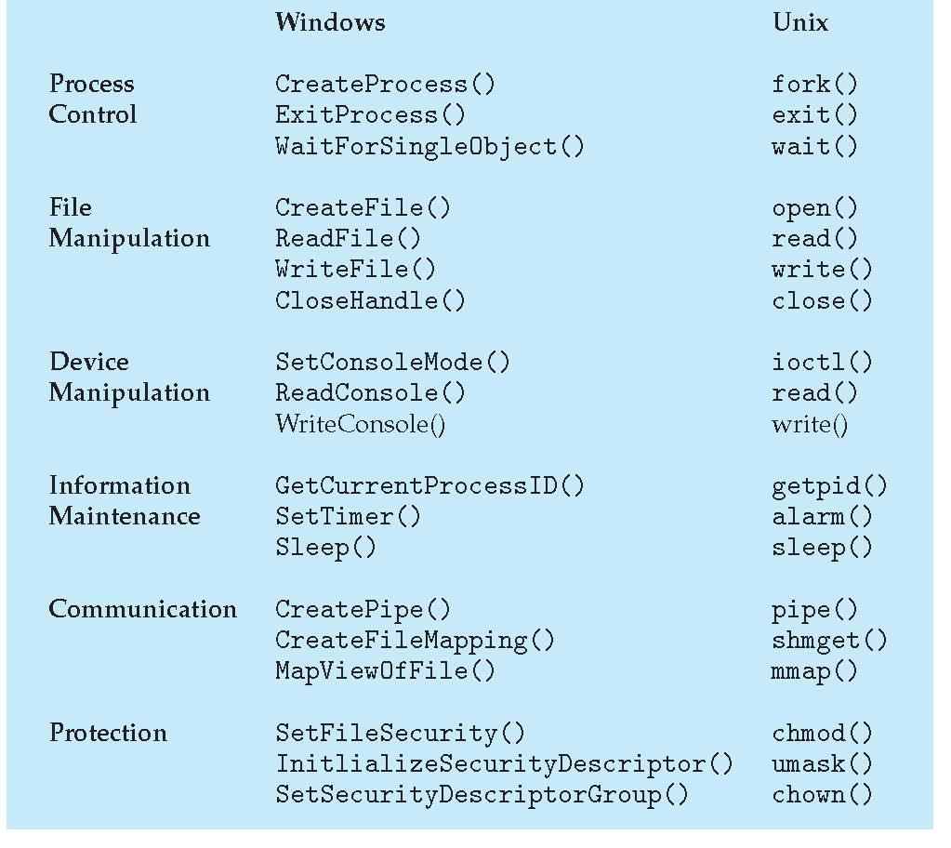
Examples of Windows and Unix System Calls
57
Notes:
57
57
57
57
57
57
57

Slide 58
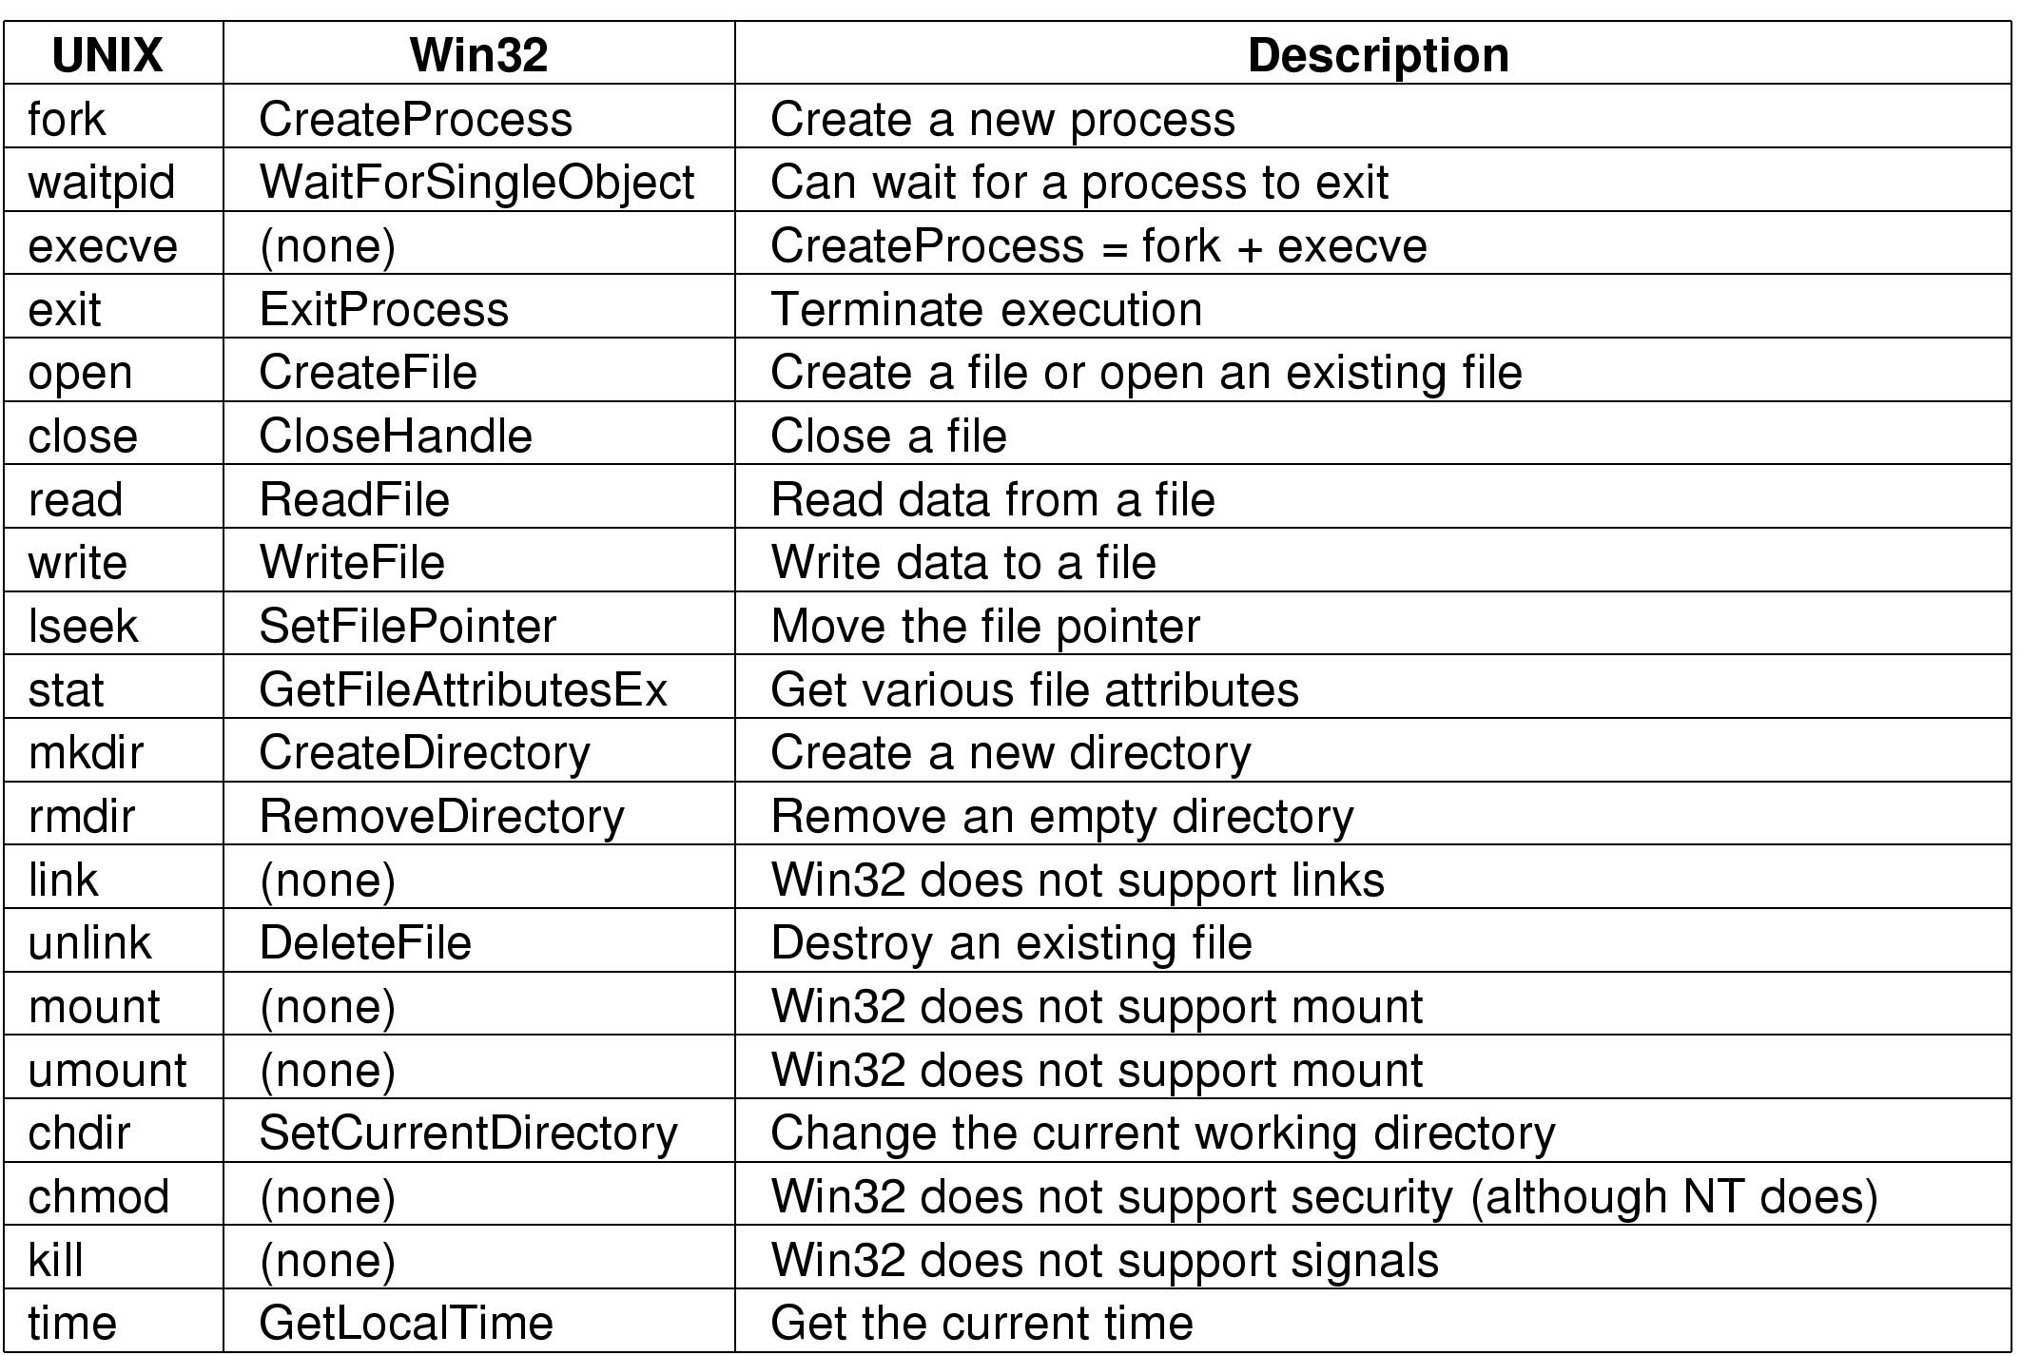
Notes:
58
58
58
58
58
58

Slide 59
Differences between library functions and system calls
System calls run in kernel-mode but library functions run in user-mode and may call system calls.
System calls are not linked to user programs.
There are only a small number of system calls.
59
Notes:
59
59
59
59
59
59

